Slide 1
Lab 1
Cindy J. Pang
Lab 1B, MWF 12:00-12:50pm
Week 1 – August 8, 2024

Slide 2


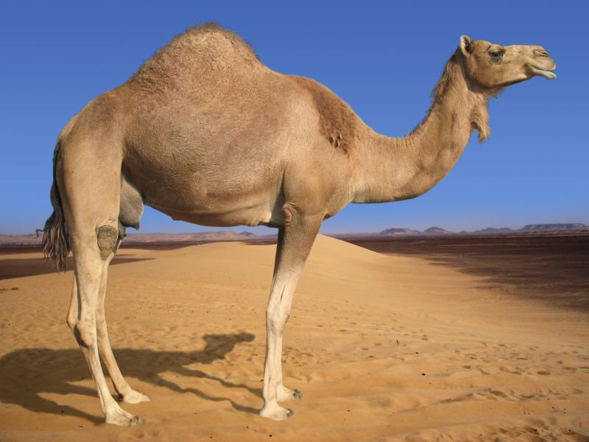
Describing a Distribution – Measures of Center

Slide 3
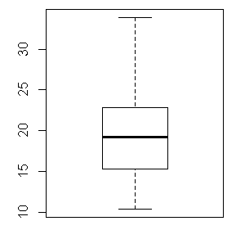


Describing a Distribution – Measures of Spread

Slide 4
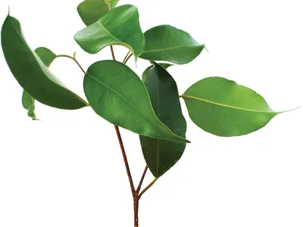
Stem & Leaf Plot
15, 16, 21, 23, 23, 31, 35, 39, 40, 41, 46, 55, 56

Slide 5
Stem & Leaf Plot
15, 16, 21, 23, 23, 31, 35, 39, 40, 41, 46, 55, 56

